Slide 1
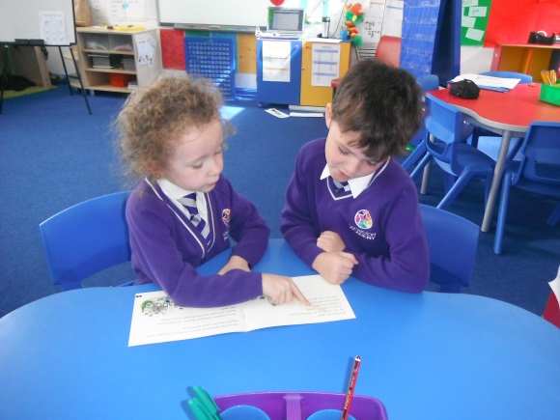
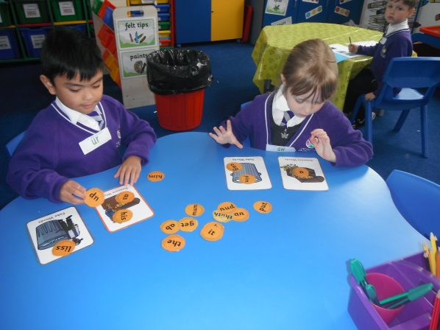
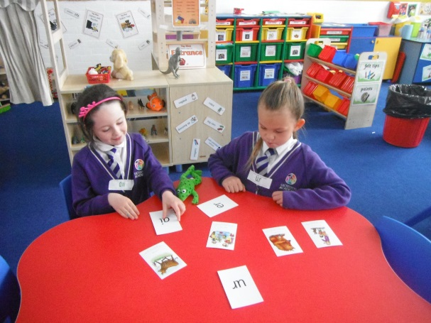
Overview of Workshop
What is phonics, why and how do we teach it?
What is the phonics screening?
How can you help your child at home?

Slide 2
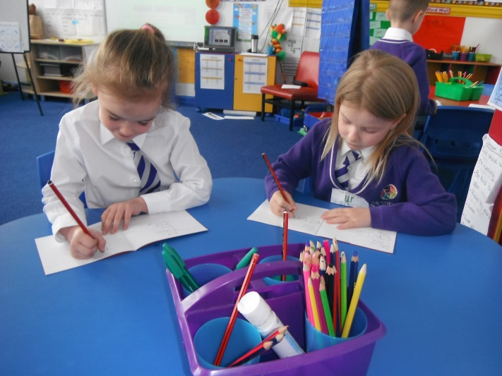
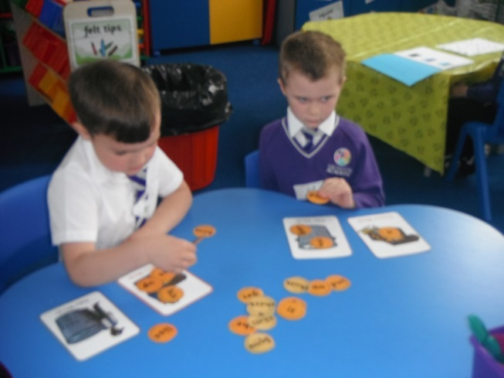
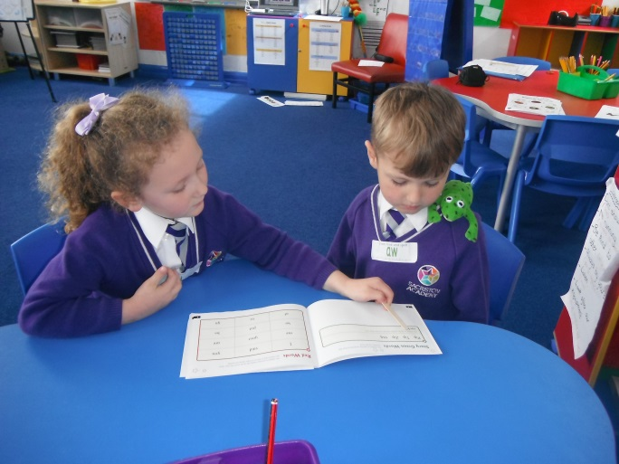
Phonics in Year 1

Slide 3
What is Phonics ?
Phonics is a way of teaching children to read quickly and skilfully.
They are taught to:
recognise the sounds that each individual letter makes;
identify the sounds that different combinations of letters make – ‘special friends’
such as ‘sh’ or ‘oo’; and
blend these sounds together from left to right to make a word.
Children can then use this knowledge to ‘decode’ new words that they hear or see. This is the first important step in learning to read.

Slide 4
How we teach Phonics at
Sacriston Academy
Children are taught a new sound or revisit a sound daily in our Read Write Inc. lessons.
Children are in small differentiated groups to meet their reading needs.
Read Write Inc is a lively and vigorous phonics programme which motivates the children.
SUCCESS – they know they will be able to decode therefore they can achieve.

Slide 5
Special Friends

Slide 7
Speed Sounds
f ff | l ll | m mm | n nn kn | r rr | s ss | v ve | z zz s | sh | th | ng nk
b bb | c k ck | d dd | g gg | h | j | p pp | qu | t tt | w wh | x | y | ch tch

Slide 8
Green Words
that Jack pink Fox kilt black long vest chest
hot’ pants hotpants flip’ flops flipflops flapp’ y flappy spott’ y spotty

Slide 9
Red Words
all me you the said

Slide 10
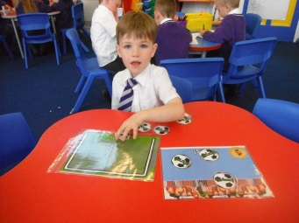
What is the Phonics Screening ?
A statutory assessment which all Year 1 children must complete.
A quick and easy check of your child's phonic knowledge.
Your child will sit with a teacher they know and be asked to read 40 words aloud.
Some of the words will be real words and some will be nonsense words.
The children will have read some of the words before, some may be new.

Slide 11
What is the Phonics Screening ?
They will simply be applying the skills they have learnt through Read Write Inc. sessions daily throughout this year.
The check takes a few minutes to complete although there is no time limit.
If any child was struggling the teacher would stop the check.
All of the children are familiar with taking part in regular one to one assessments so hopefully the screening check wont phase them.
The check will take place during the week
beginning 10th June

Slide 12
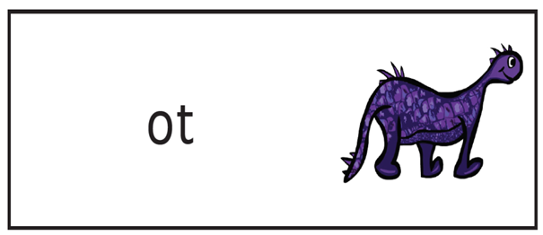
What are ‘nonsense’?
Our children call these alien words.
osk
choot
shirp

Slide 13
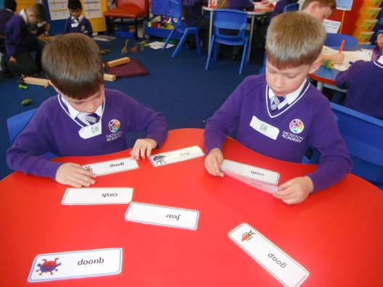
What happens after the Check?
You will be informed of your child's progress in phonics as part of your child's end of year progress report in July.
The pass rate – Last years pass rate was 32/40
Teachers will plan the next steps to ensure all children receive the right support and intervention to make further progress in phonics.

Slide 14
Helping your Child at Home
Use the word lists in back of your child's reading diary
Read words in and out of context
Make up your own alien words using the sounds from the mat for your child to learn
Use the reading mat to secure knowledge of all sounds
Read frequently a range of texts and sign your child’s diary to let us know how they are getting on.

Slide 15
Any
Questions

