Slide 1
Key Stage One SAT’s
Information for Parents
Monday 10th February 2020

Slide 2
SAT’s
During the month of May 2020 (Week beginning Monday 11th May), Year 2 children will sit tests in:
Maths
Reading
Spelling, punctuation and grammar
These tests are set externally and marked internally.
Your child’s marks will be used in conjunction with teacher assessment to give a broader picture of their attainment.

Slide 3
How will my child be tested?
The children will be split into small groups to complete the test.
They will be under ‘test conditions’ but this is presented to them so it give them the space and quiet to concentrate.
We have been practising these skills already in class.

Slide 4
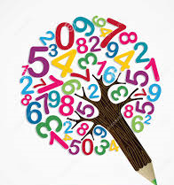

MATHS
Children will sit two tests: Paper 1 and Paper 2:
Paper 1 is for arithmetic, lasting approximately 25 minutes and worth 25 marks. It covers calculation methods for the four operations as well as fractions.
Paper 2 covers problem solving and reasoning. This paper lasts for approximately 35 minutes and is worth 35 marks. This paper includes some (5) mental maths questions.
**Children are not given access to any resources to support them**

Slide 5
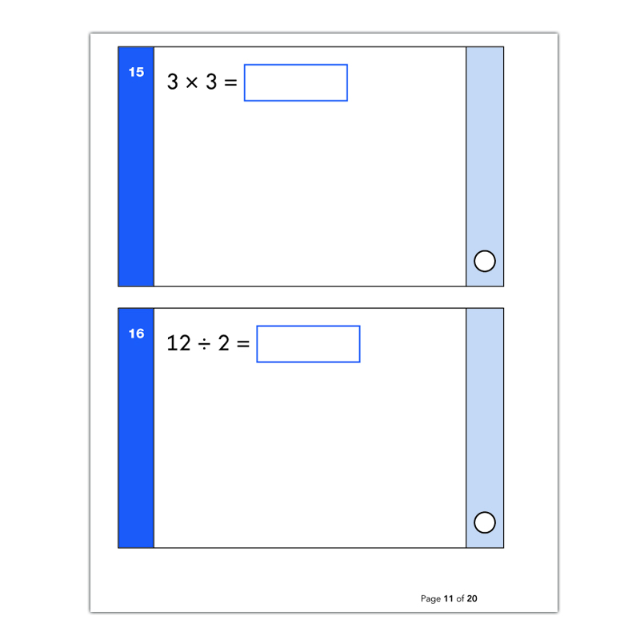
Example question – Paper 1 Arithmetic
25 questions

Slide 6
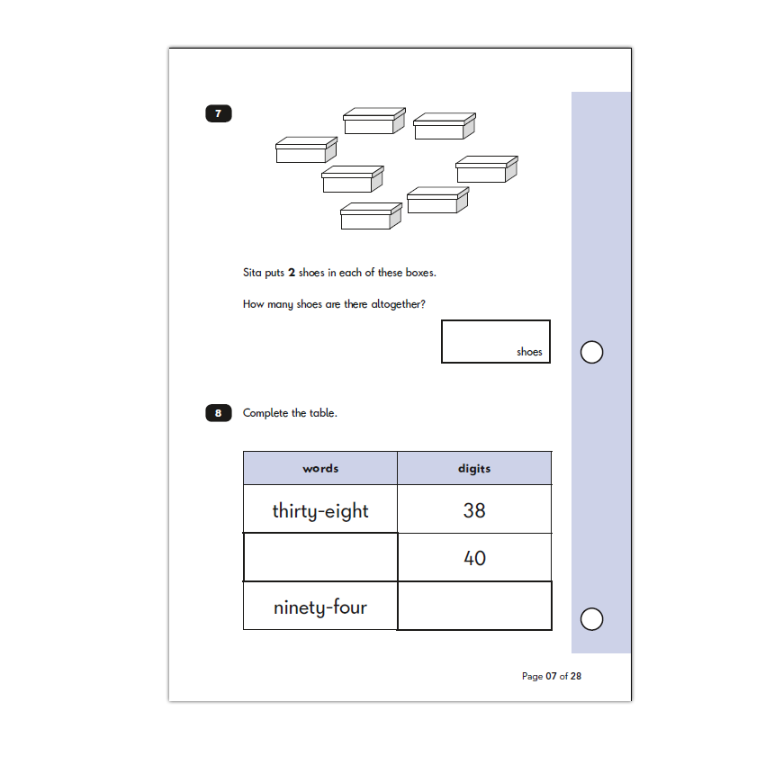
Example question – Paper 2 reasoning
The children are able to ask for these questions to be read to them.

Slide 7

READING
The Reading Test consists of two separate papers:
Paper 1 – Contains a selection of texts totalling between 400 and 700 words with questions about the text.
Paper 2 – Contains a reading booklet of a selection of passages totalling 800 to 1100 words. Children will write their answers to questions about the passage in a separate booklet.
Each paper is worth 50% of the marks and should take approximately 30 minutes to complete, although the children are not being assessed at working at speed so will not be strictly timed.
The texts will cover a range of poetry, fiction and non-fiction.
Questions are designed to assess the comprehension and understanding of a child’s reading.
Some questions are multiple choice or selected response, others require short answers and some require an extended response or explanation.

Slide 8
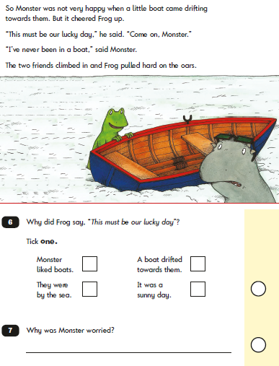
Example question – Paper 1

Slide 9
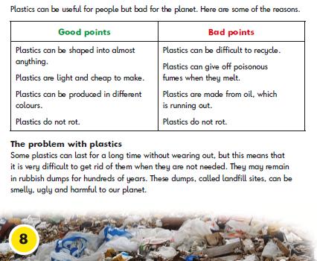
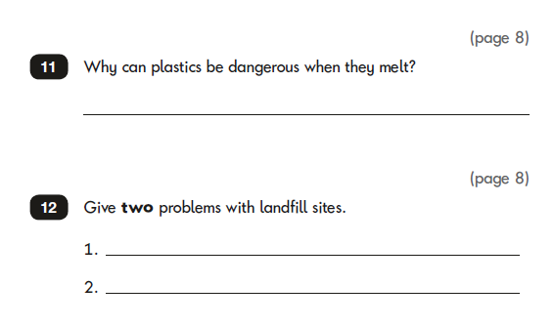
Example question – Paper 2

Slide 10
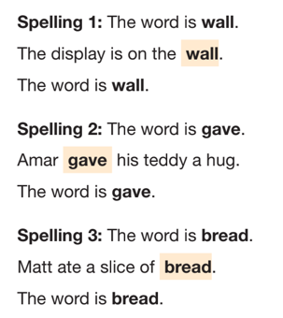
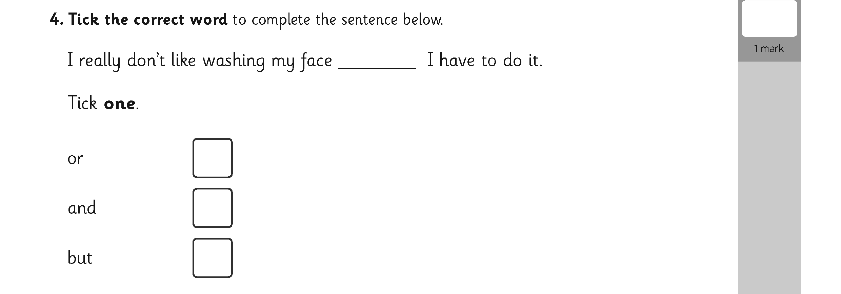

Spelling, punctuation and grammar
The SPAG test is optional. However, I will be using it to support my writing judgements nearer the end of the school year.
The test consists of two separate papers:
Paper 1: spelling (20 marks)
Paper 2: questions (20 marks)
The spelling test will consist of spelling rules that the children have learnt in school and are given weekly to practice at home.
E.g. Words where the ‘or’ sound is spelt ‘a’ within words.

Slide 11


WRITING AND SCIENCE
These two subject are teacher assessed.
Writing is judged from a number of pieces of work the child has produced in a variety of genres.
Science is judged from the outcome of each science topic based on their knowledge of the content and their ability to ‘work scientifically’ .

Slide 12
Assessment and Reporting
Teacher assessments are also used to build up a picture of your child’s learning and achievements. In addition, your child will receive an overall result saying whether they have achieved the required standard in the tests.
Children are given a scaled score. Their raw score – the actual number of marks they get – is translated into a scaled score, where a score of 100 means the child is working at the expected standard.

Slide 13
Scaled Scores
Scaled Score | Attainment ARE (Age Related Expectation)
95 | Working well below expected standard
98 | Working below expected standard
100 | expected standard
102 | Above expected standard
110+ | Working at High Standard
The scale will have a lower end point below 100 and an upper end point of 120.

Slide 14
The results from the end of Key Stage Tests / Teacher assessment are included on your child's report at the end of the school year.
Tests | Scaled Score | Outcome
Reading | 113 | Has Met the expected standard
Grammar, Punctuation & Spelling | 105 | Has Met the expected standard
Maths | 93 | Has Not Met the expected standard
Subject | Teacher Assessment
Reading | Working at the expected standard
Writing | Working below /at expected / at greater depth
Maths | Working at the expected standard

Slide 15
SEND
There is a small percentage of pupils who will be working below the standard of both the national curriculum tests and the interim teacher assessment frameworks.
Many of these pupils have special educational needs. Others may be working below the standard of the national curriculum tests for a range of reasons.
These children will be recorded as:
Pre-Key Stage One

Slide 16
How can you help at home?
First and foremost, support and reassure your child that there is nothing to worry about and they should always just try their best. Praise and encourage!
Best possible attendance at school
Read as much as possible with your child (this does not need to be their school reading book) and return their reading folder every day
Please make sure extra homework is completed. E.g. spellings practiced

Slide 17


Questions?

